Slide 1
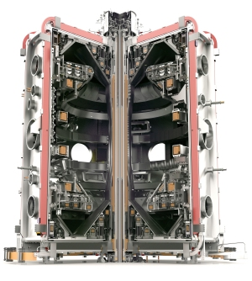
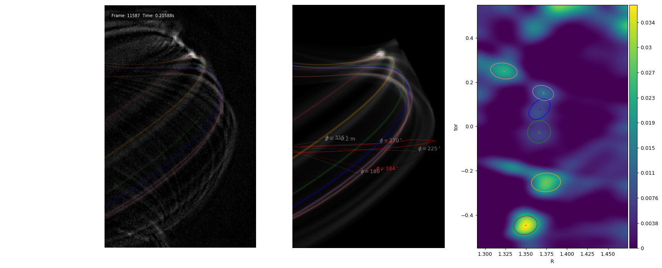
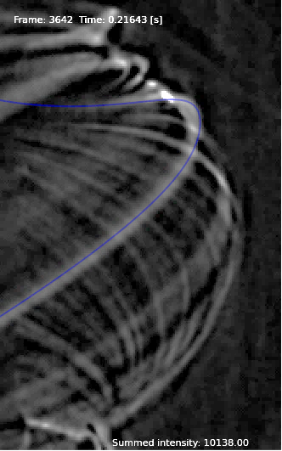
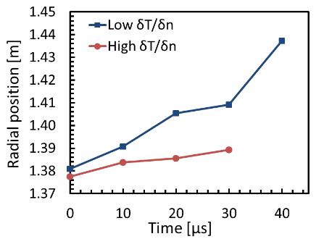


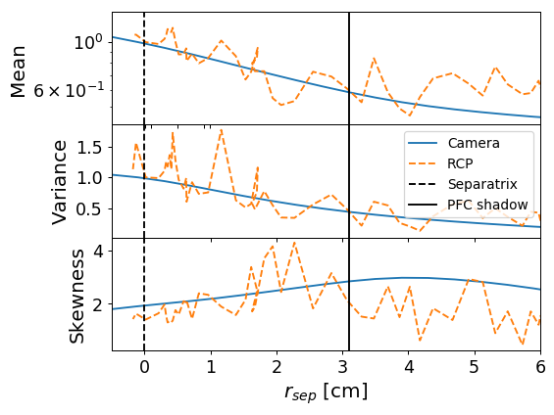



0.6
6th FuseNet PhD Event
ITER, November 2018
Tom Farley, Fulvio Militello, Nick Walkden, Andrea Piccione, Giuliana Sias,
James Harrison, James Bradley

Slide 2
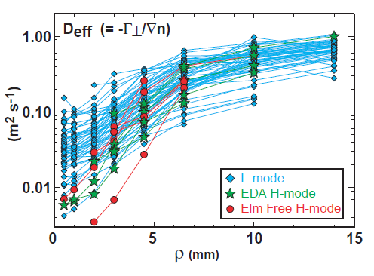
Flux of particles
Density gradient
Garcia (2007)
LaBombard (2000)

Slide 3
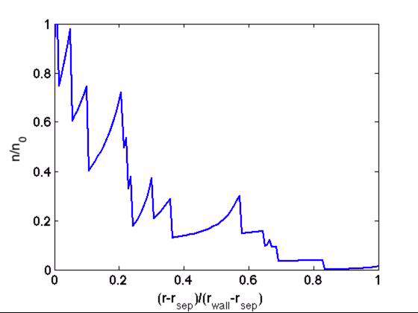
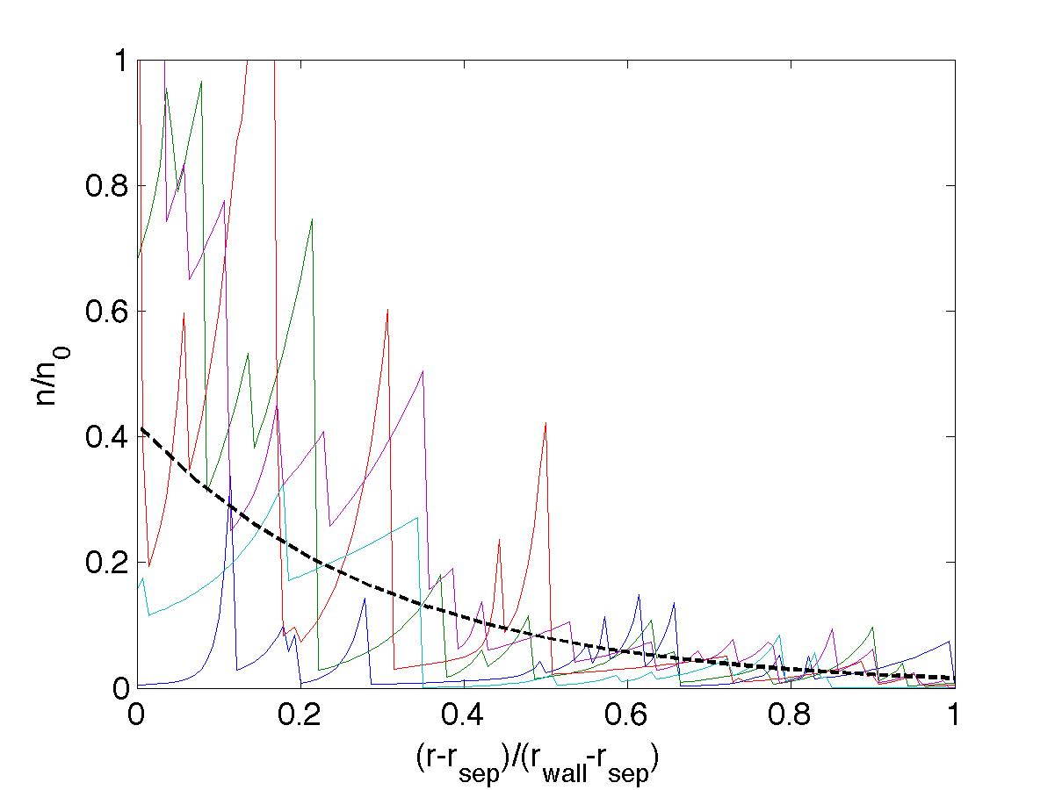
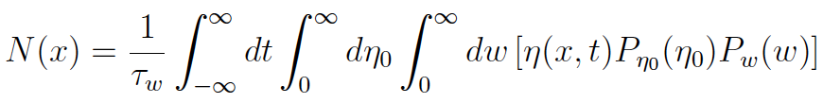
Militello NF Letters and PPCF (2016)

Slide 4
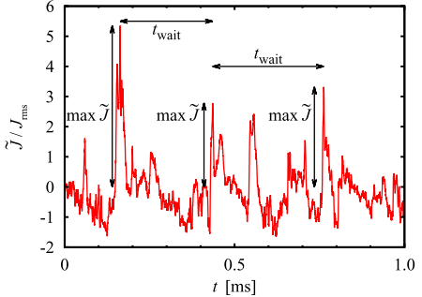
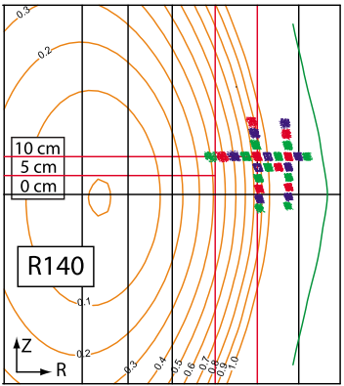
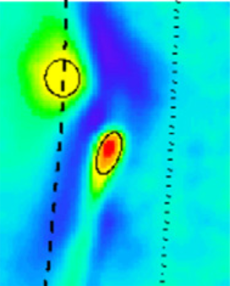
Langmuir probe
Beam Emission Spectroscopy
Gas Puff Imaging

Slide 5
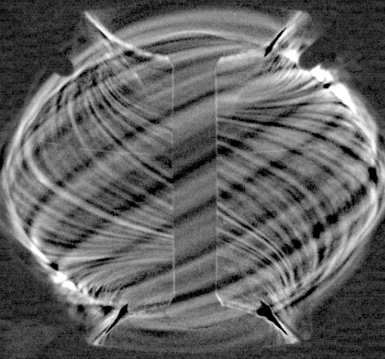
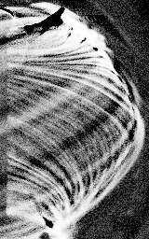

Slide 6
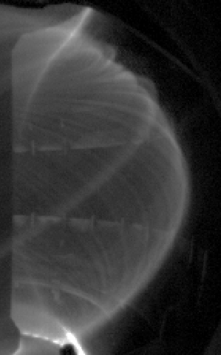
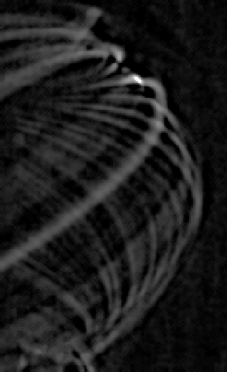
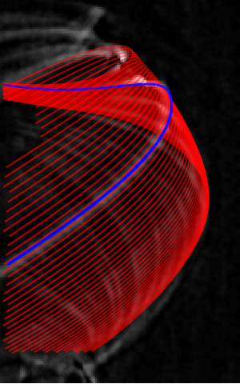
2
1

Slide 7
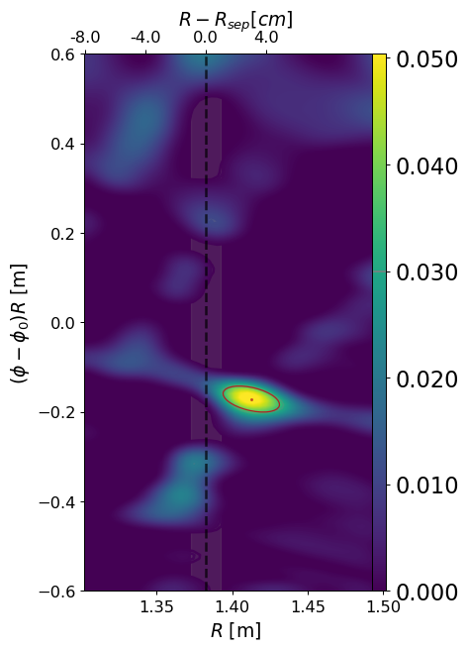
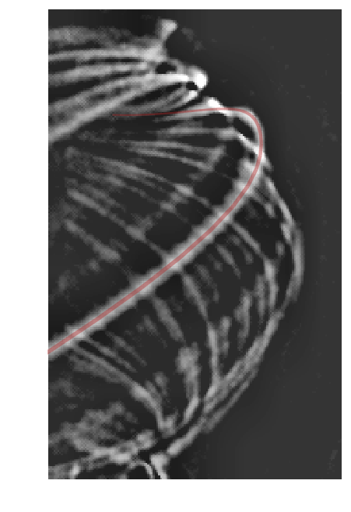





$$Z$$
$$R$$
$$R$$
Mid-plane
$$φ$$
Filament
$$φ$$

Slide 8
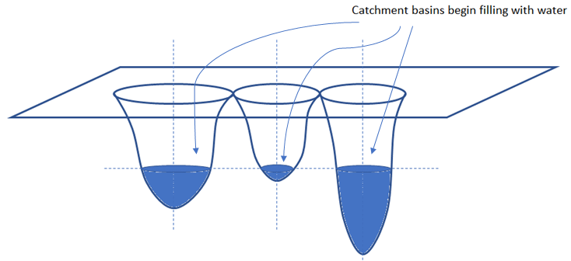
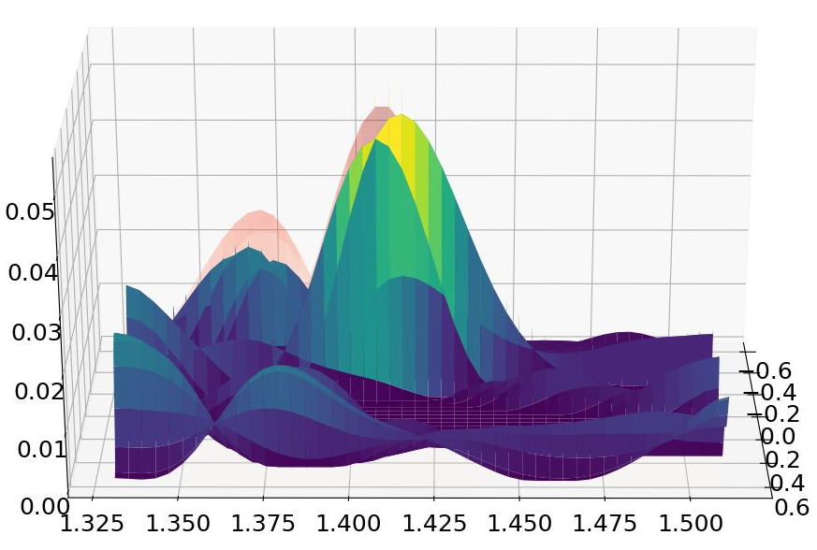

Slide 9
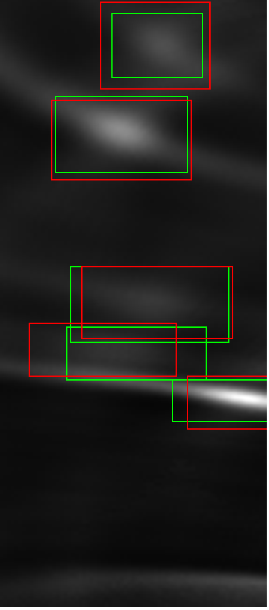
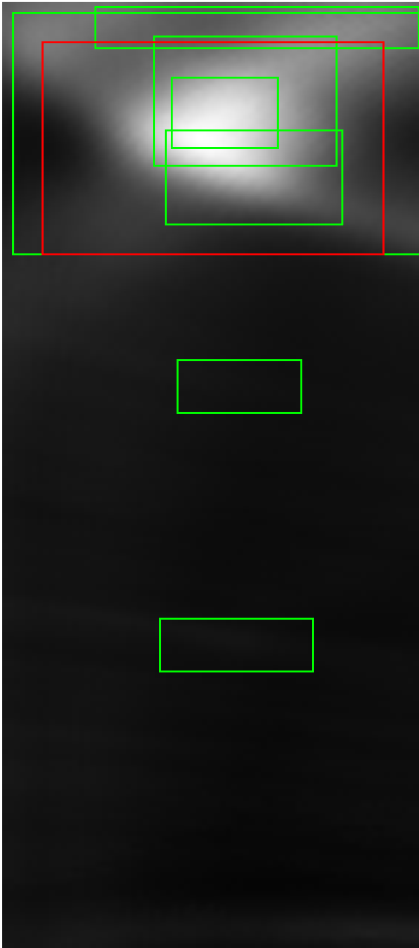




$$Image \#4813$$
$$Image \#4948$$
$$Image \#4813$$
$$Image \#4948$$

Slide 10
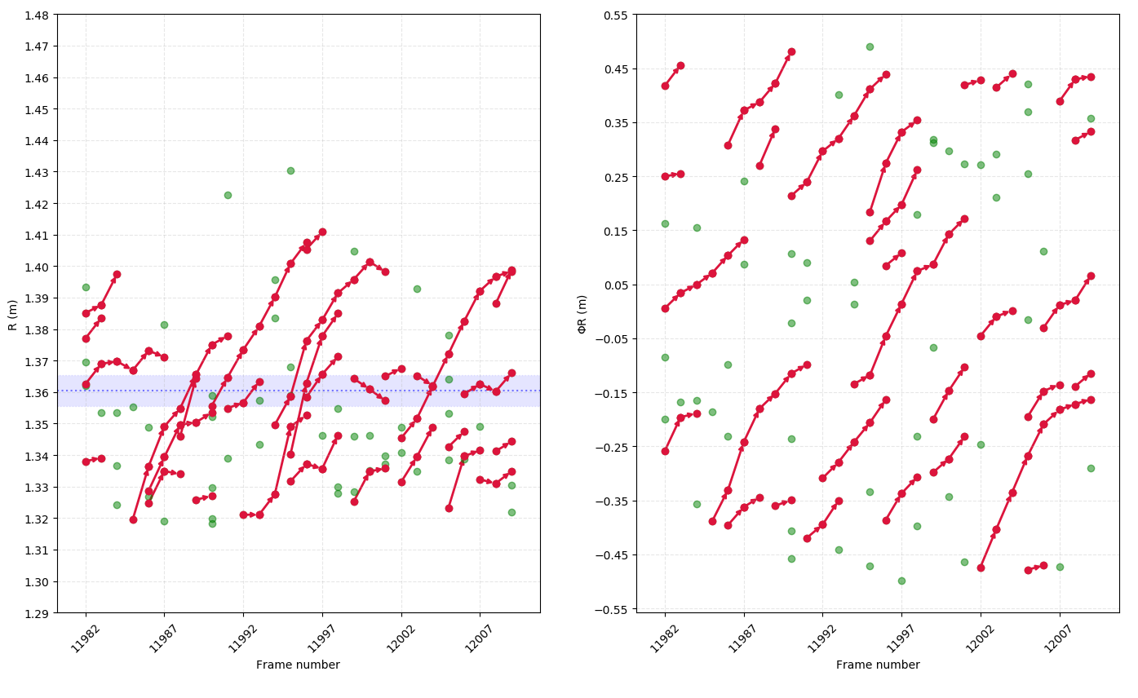


Radial motion
Toroidal motion
ΦR
t
$R$ [m]
$φR$ [m]
R
t
Frame number
Frame number

Slide 11
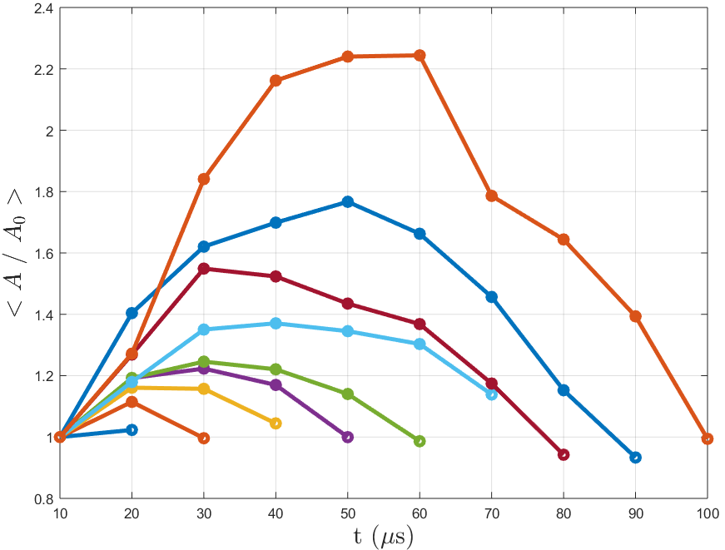
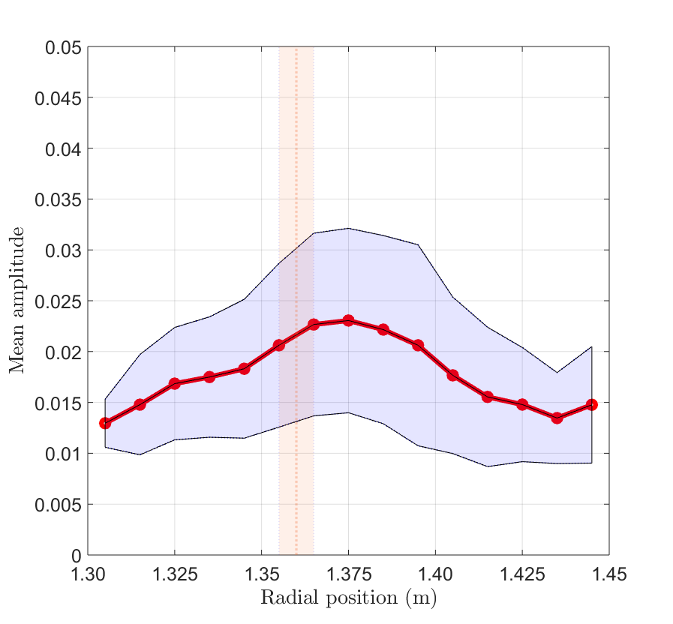

Low neutral
density
Parallel drainage
of flux tubes
$$\left\langle A/A_{0}\right\rangle$$

Slide 12
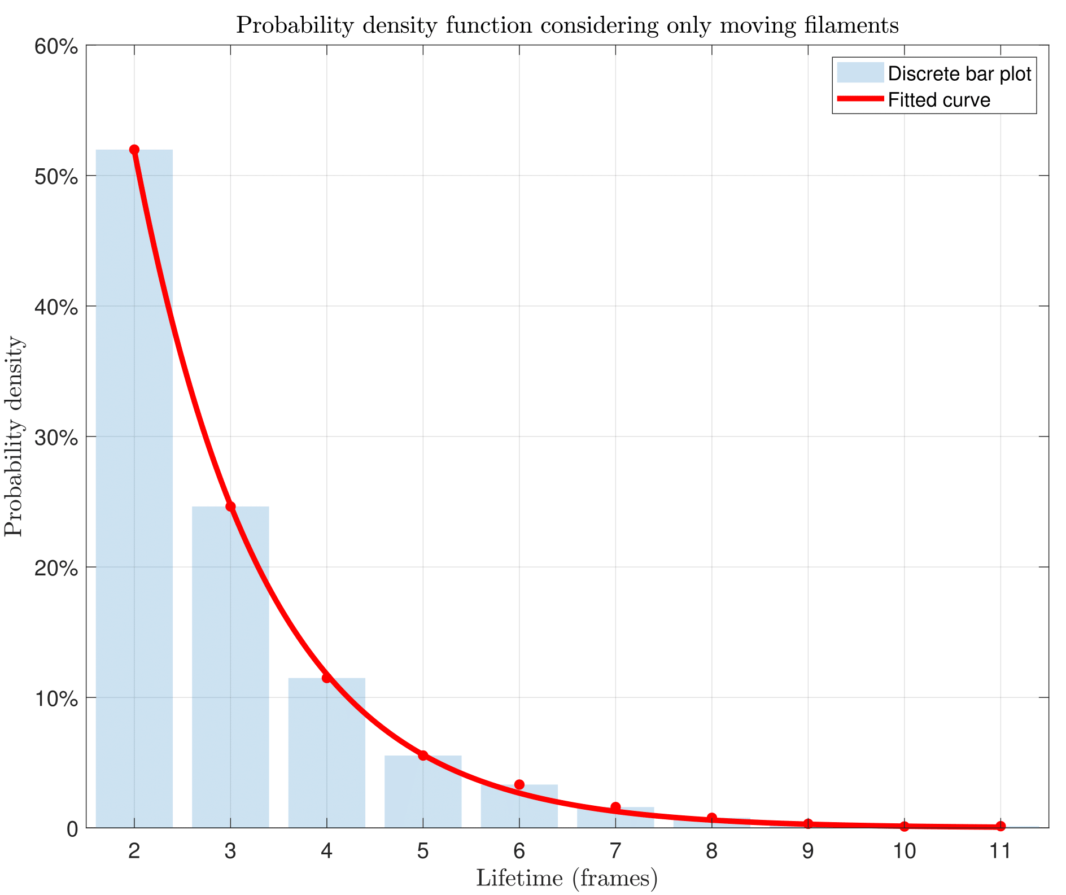

Slide 13
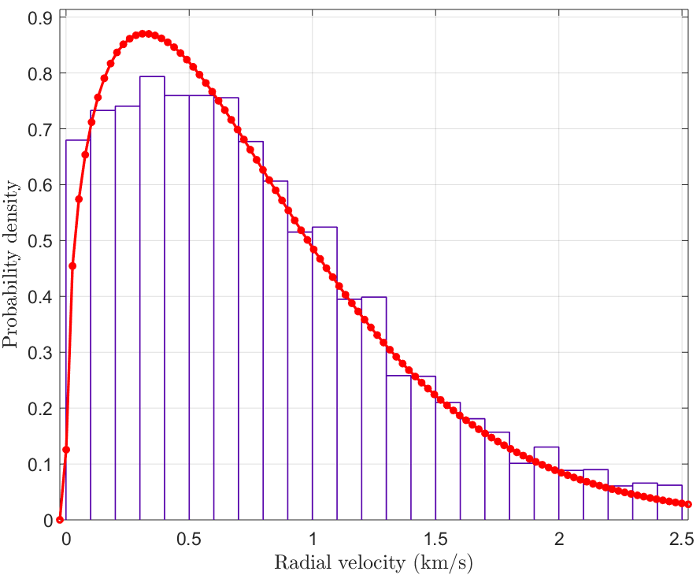
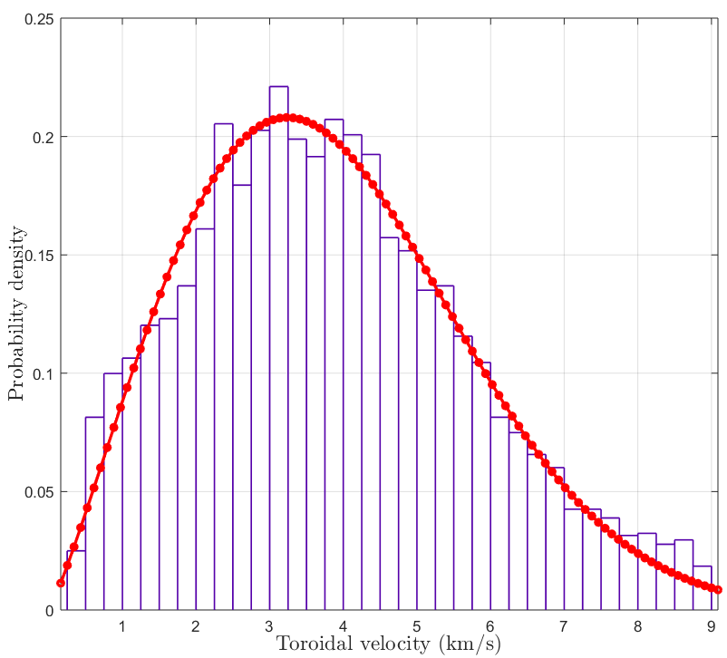

Slide 14
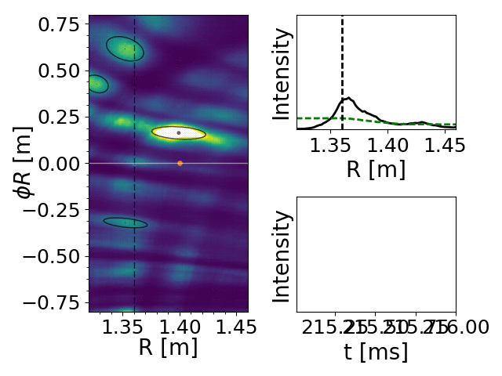
215 216

Slide 15
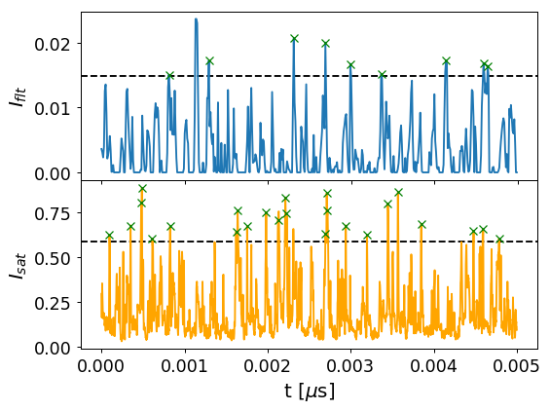
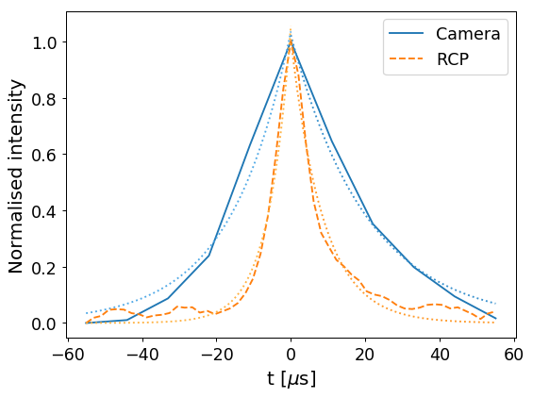

t$[s]$

Slide 16
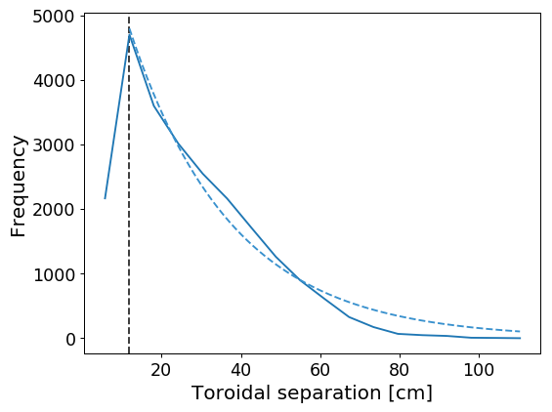

Slide 17
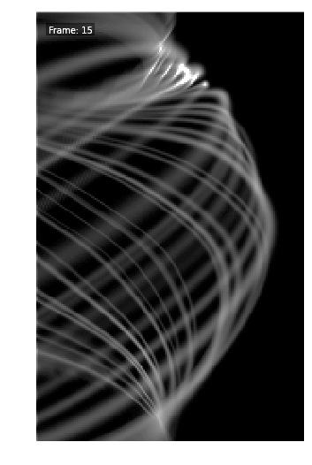
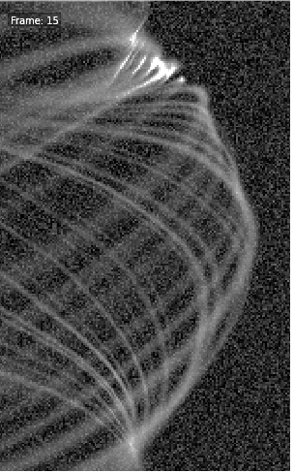
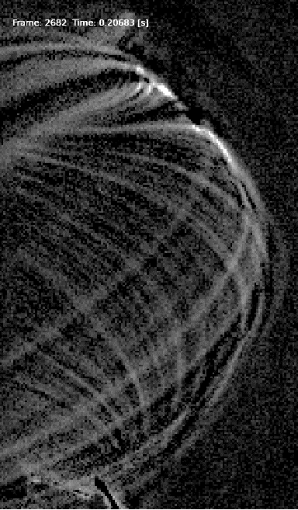
Original synthetic frame
Synthetic frame + noise
Experimental frame

Slide 18
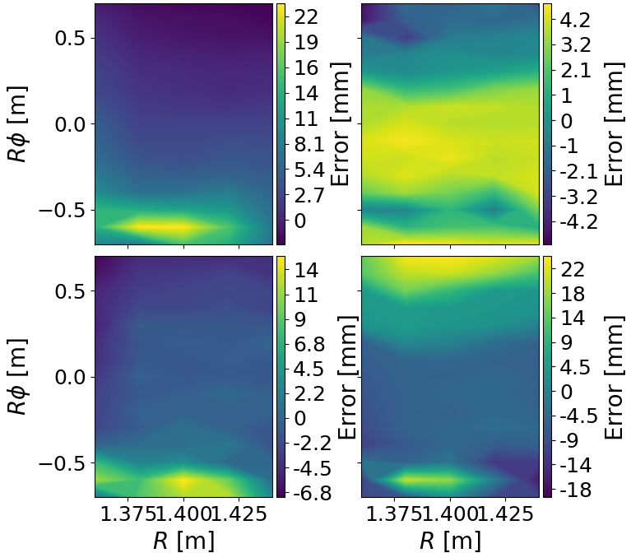
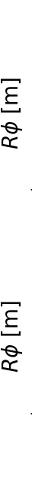
Radial
position
Toroidal
position
Radial
width
Toroidal
width
1.375 1.425
1.375 1.425

Slide 19
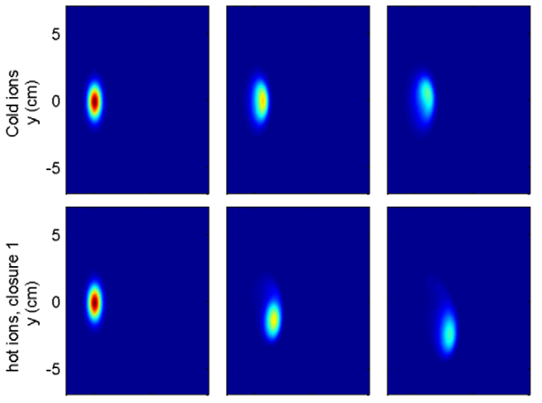

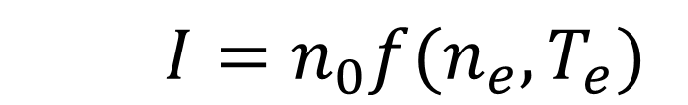
STORM (Bout++)
    $$I=n_{0}f({n_{e},T}_{e})$$
Militello PPCF (2016)

Slide 20
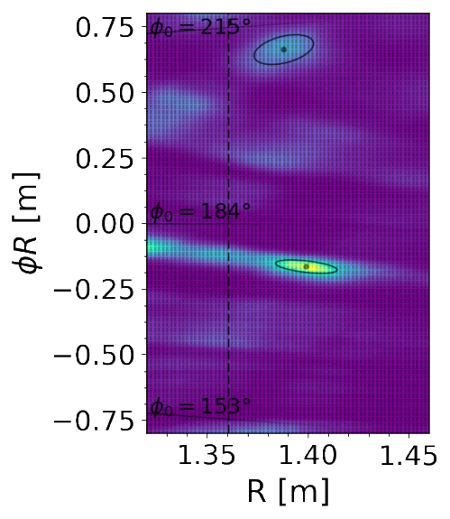
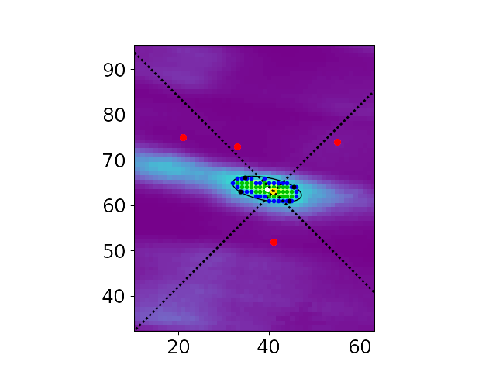
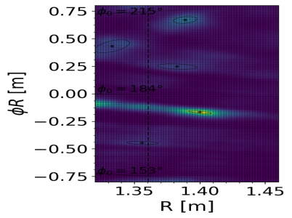
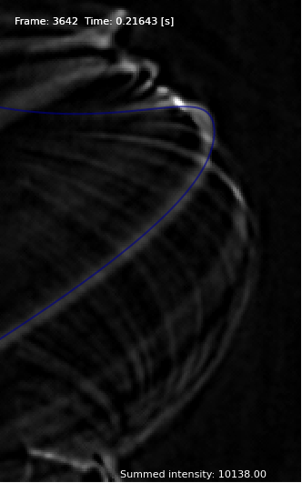
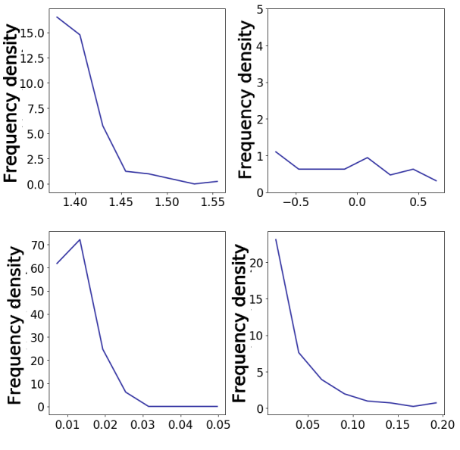
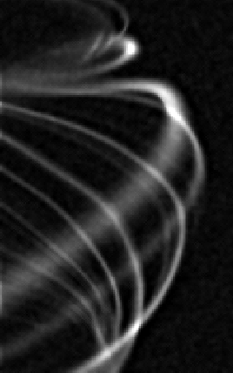
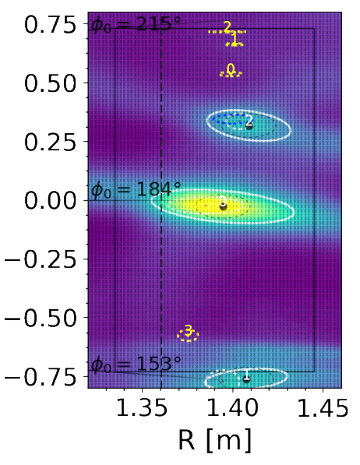

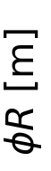








Raw
Background subtracted
Project field lines
Inversion
Filament detection
1
2
3
4
Filament
Filament
Filament
Input Filament PDFs
Synthetic frames
Filament detection
Error quantification
$$φ$$
$$Z$$
Radial
position
Toroidal
position
$$R$$
Radial
position
Toroidal
position
A
B
C
$R−φ$ plane at $Z=0$ m
(mid-plane)
$R$ [m]
$Rφ$ [m]
Radial
width
Toroidal
width
Radial
width
Toroidal
width
$ΔR$ [m]
$Δ\left(Rφ\right)$ [m]
Tom.Farley@ukaea.uk

